Slide 1
VINTAGE ANALYSIS
Vikram Dewangan

Slide 2
Vintage? - You might recognize the term if you're a fan of aged wines or spirits.
When it comes to deciding y (dependent variable) for statistical models in credit risk, Vintage analysis and roll rate analysis comes into picture.
Vintage analysis helps us to decide the time period for which the loan should be tracked to evaluate the loan. As per BASEL, 90+ dpd is the definition of default, and that can be well supported by Vintage analysis.
Must have variables in data for vintage analysis:
Loan Id
Reporting Month
Origination Date
Bucket
Calculated columns:
Months on Books (MOB)
Delinquency Status

Slide 3
Data to destiny
Calculated Columns
Pivot table
Calculation of default rate
Plotting
Creating MOB (= Reporting Date – Origination Date) column.
Creating Delinquency status column to capture the days past due (dpd).
Create pivot table to capture 30 dpd, 60 dpd, 90 dpd.
Calculate default rate for each MOB for every default definition.
Plot default rate against Month on Books for every default definition.

Slide 4
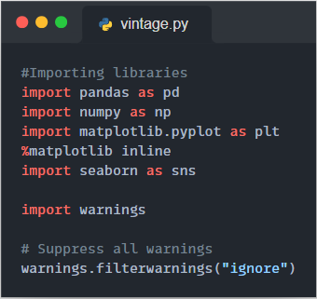
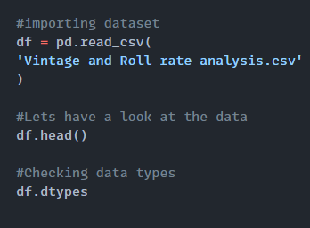
Importing necessary libraries
Reading datasets and checking data type

Slide 5
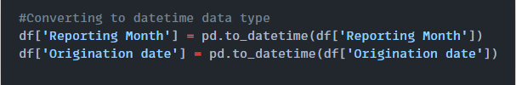
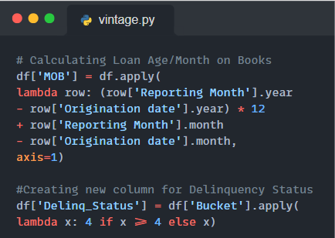
Converting date columns to datatime data type
Creating new columns Month on Books and Delinquency Bucket

Slide 6
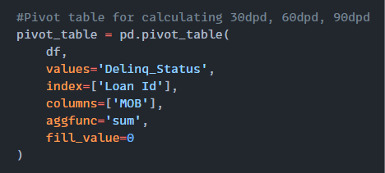
Pivot tables for calculating different default definition

Slide 7
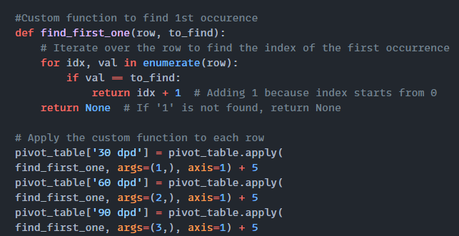
Find 1st occurrence of 1 in each row for 30 dpd, 2 for 60 dpd, 3 for 90 dpd

Slide 8
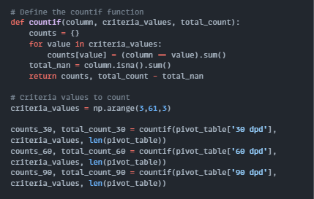
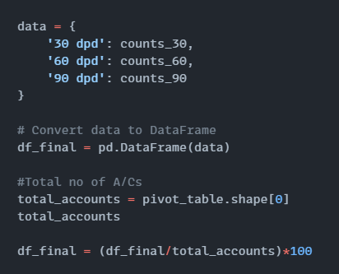
Preparing final data – Calculating default rate

Slide 9
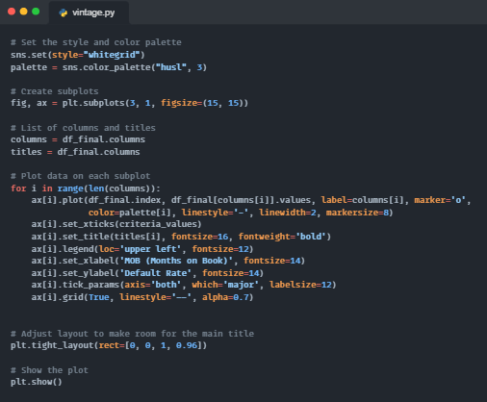
Plotting graphs for 30 dpd, 60 dpd, 90 dpd

Slide 10
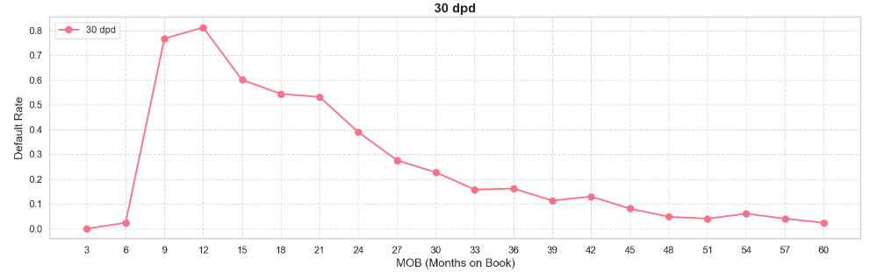
Default rate is highest at 12 MOB when 30 dpd is the default definition.

Slide 11
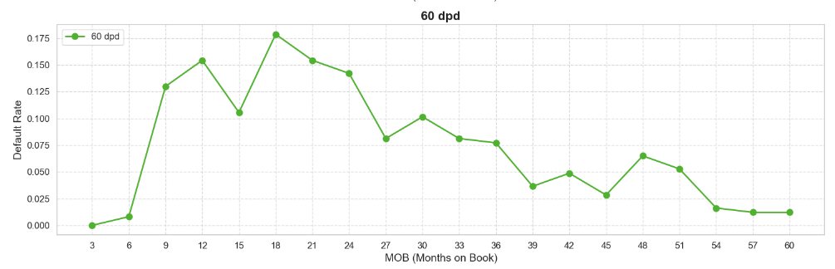
Default rate is highest at 18 MOB when 60 dpd is the default definition.

Slide 12
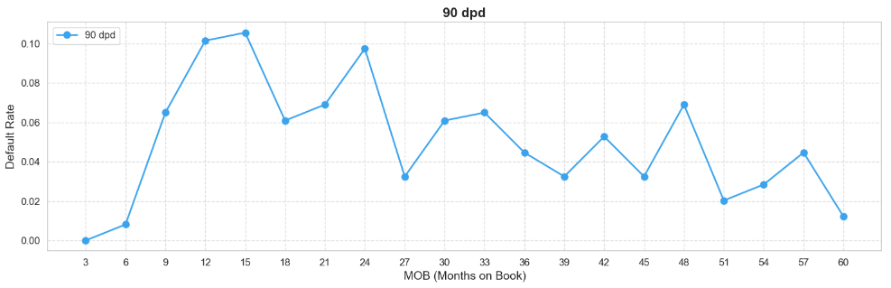
Default rate is highest at 15 MOB when 90 dpd is the default definition.

Slide 13
ROLL RATE ANALYSIS

Slide 14
Roll Rate analysis helps us to decide default definition. Definition of default is the dpd bucket beyond which the chances of cure is very low and chances of turning out worst in more.
Must have variables in data for roll rate analysis:
Loan Id
Reporting Month
Bucket
Calculated columns:
Source Bucket
Destination Bucket

Slide 15
Data to destiny
Filter A/Cs
Source and Destination Bucket
Transition Matrix
Plotting
Filter all the rows where we have 12 reporting months.
Take snapshot and performance date and bucket corresponding to that.
Create transition matrix and calculate roll forward and roll backward rate.
Plot roll backward rates against each bucket and select default definition.

Slide 16
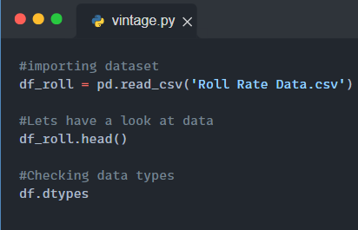
Importing necessary libraries
Reading datasets and checking data type

Slide 17
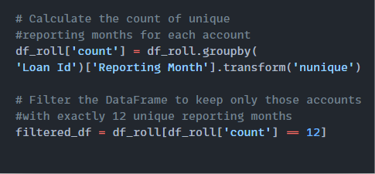
Keep all the Loan Id for which there are 12 reporting month

Slide 18
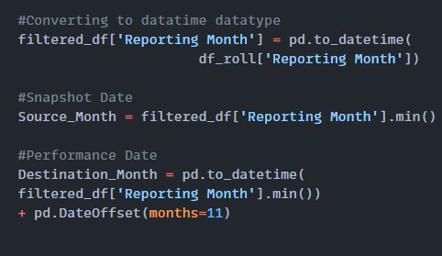
Converting Reporting column to data time data type and taking snapshot date and performance date

Slide 19
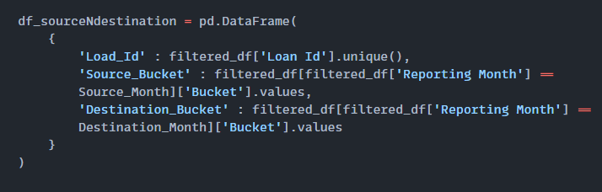
Preparing final data – Combining Loan Id, Source Bucket and Destination Bucket

Slide 20
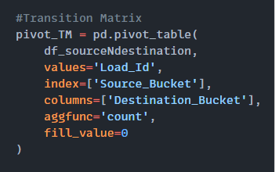
Preparing Transition Matrix

Slide 21
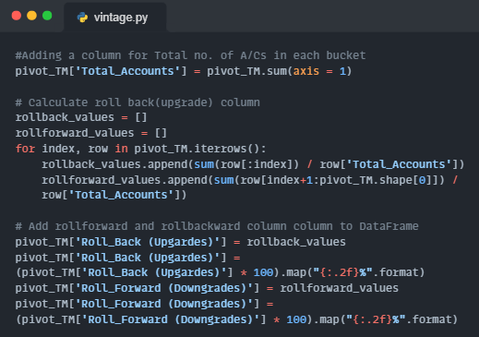
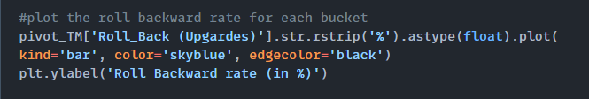
Calculating and Plotting Roll forward and Roll Backward rate

Slide 22
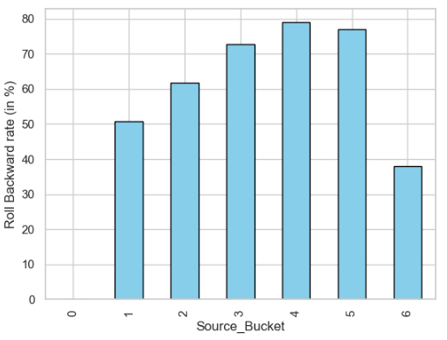
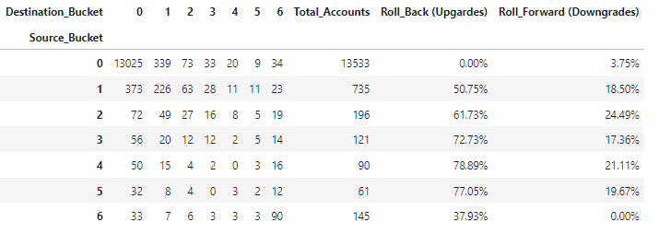
Result of roll rate analysis
We will take 150+ dpd (bucket 6) as definition of default as chances of curing of accounts after that is very low.

